Slide 1

Final Demo
The Tech Devils

Slide 2
Table of Contents
Introduction
Project organization
project description
The system
Living room
bedroom system
Door system
Kitchen system
Administrator system
Lessons learnt
technical challenges
teamwork challenges
Demo
Questions

Slide 3

Project Organization
Speaker: Mitchell van ‘t Kruys

Slide 4
Project organization
Team members:
Viktor Florea - 3880346
David Horvath - 3698009
Mitchell van ‘t Kruys - 4058151
Luuk Vogel - 3850560
Mentors/tutors:
Xeumei Pu
Jaap Geurts

Slide 5
Project Description
Speaker: Mitchell van ‘t Kruys

Slide 6
Project Description
Ambient and smart facility
Requirements
key system
adaptive lighting system
customized lighting
smoke detector
air conditioner
Project scope
Deliverables
Project plan
system design
product: the prototype
final report
final presentation

Slide 7
The System
Speaker: Mitchell van ‘t Kruys

Slide 8
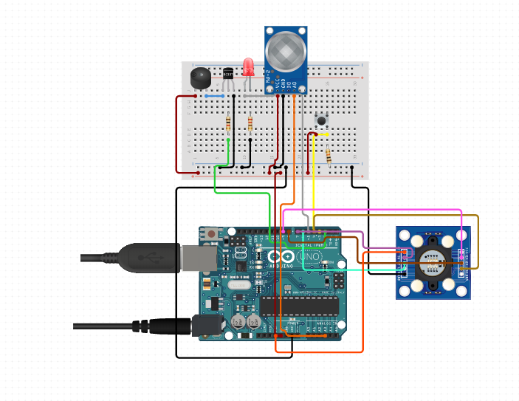
The kitchen System
Speaker: Mitchell van ‘t Kruys

Slide 9
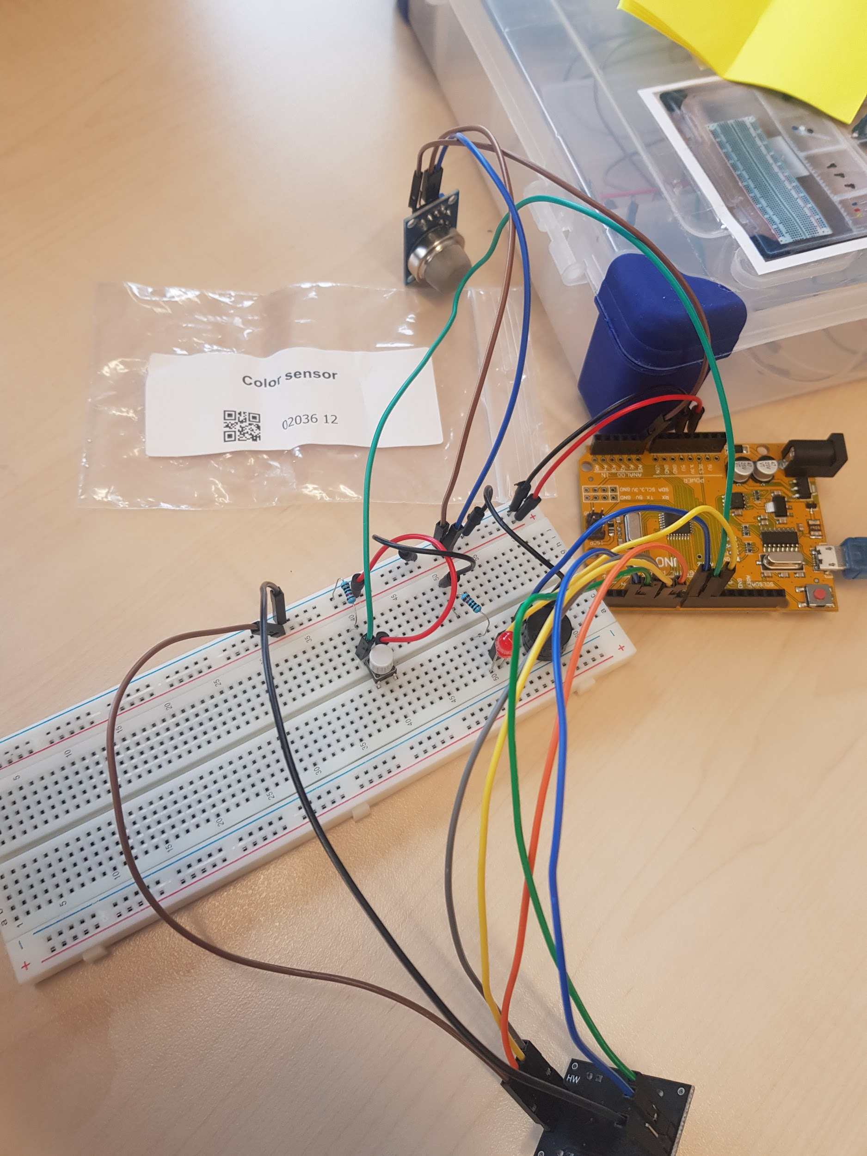
Kitchen System
Mq2-Gas sensor
buzzer
led
button

Slide 10
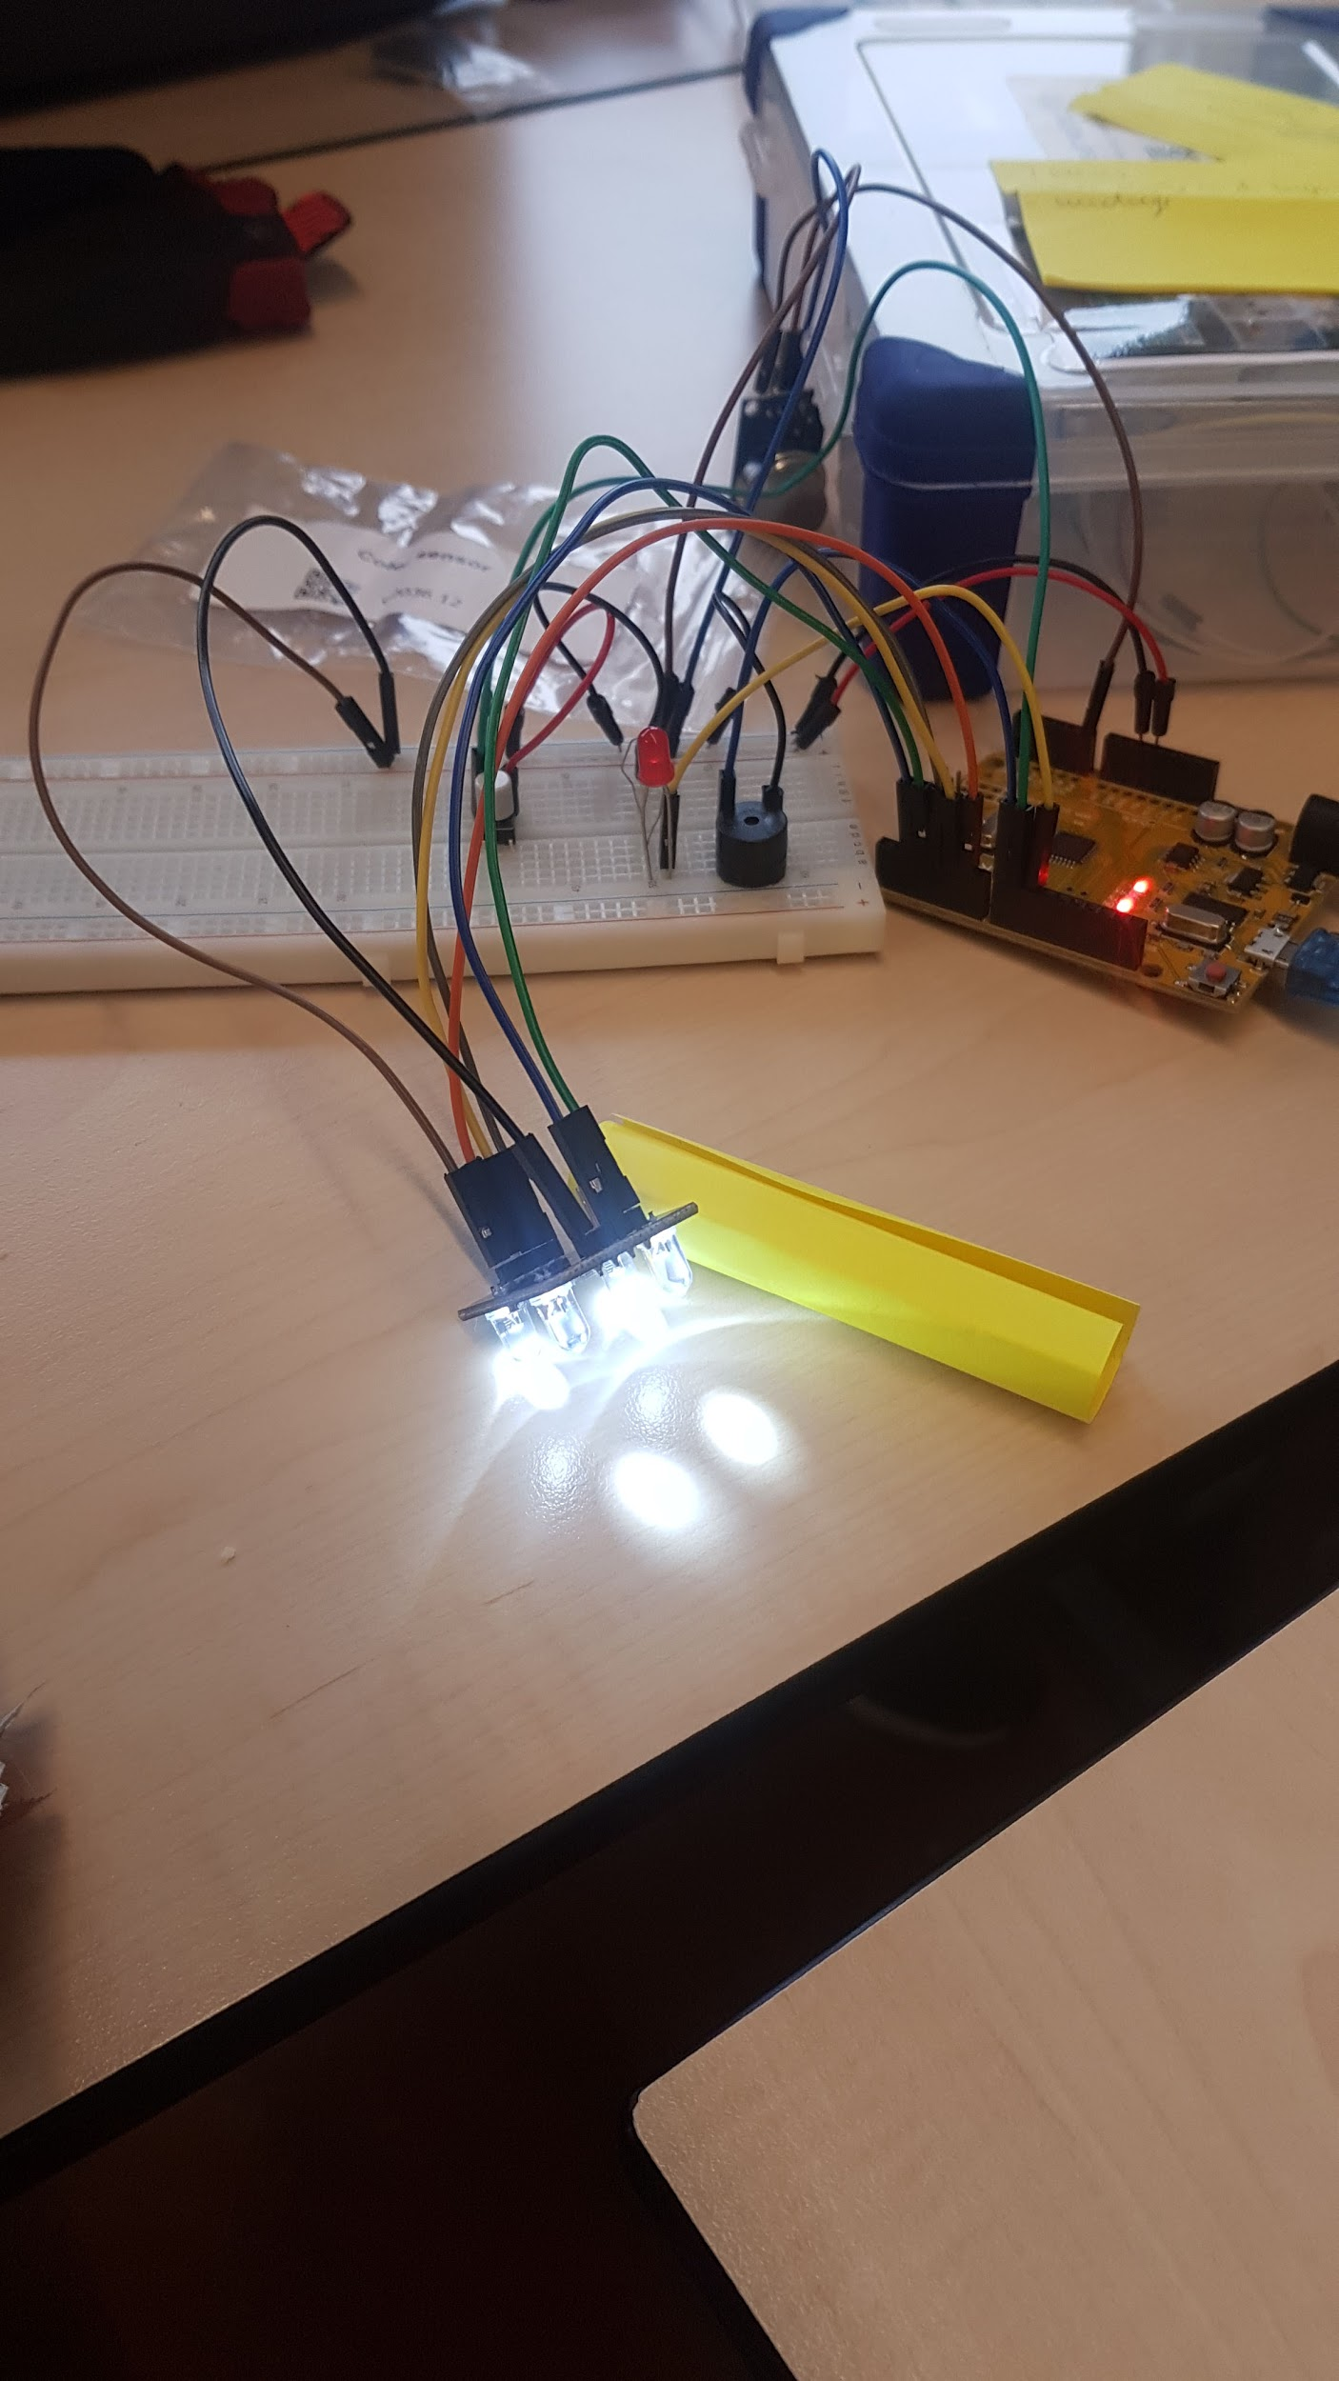
Kitchen System
TCS3200 color sensor
blue - water
green - vegetables

Slide 11
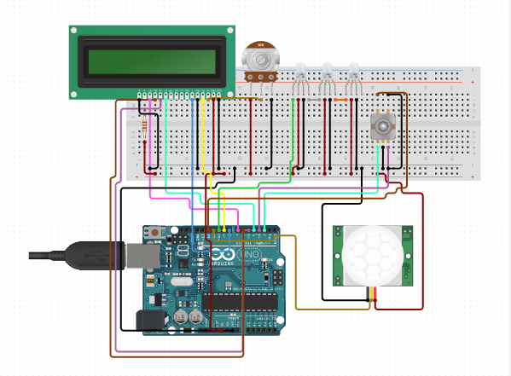
The Living Room System
Speaker: Viktor Florea

Slide 12
Living Room System
Rotary encoder
LCD menu screen
Adaptive/mood lighting
PIR sensor

Slide 13
Administrator System
Speaker: Viktor Florea

Slide 14
Administrator System
Functionality
Communication
Speaker Viktor Florea

Slide 15
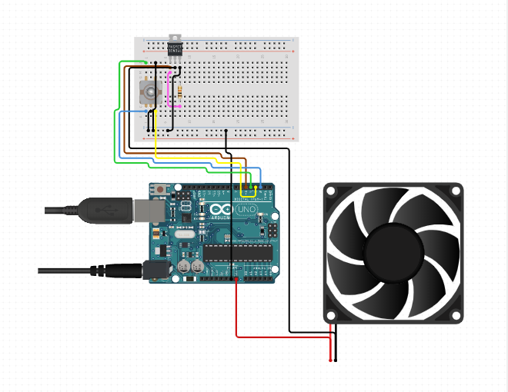
The Bedroom System
Speaker: Luuk Vogel

Slide 16
Bedroom System
Fan
Control with LCD menu
Control with rotary encoder
Automatic control by dht11 sensor

Slide 17
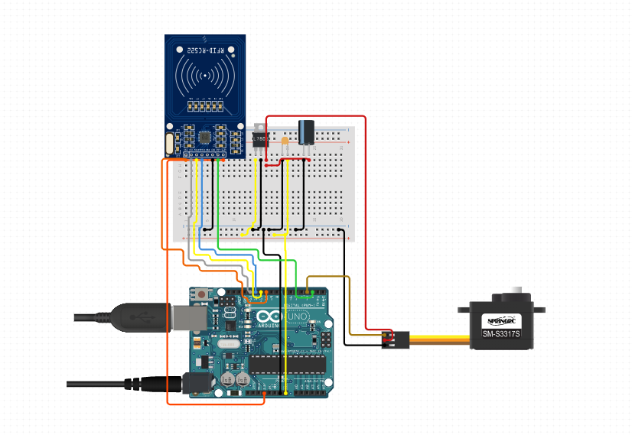
Door System
Speaker: David Horvath

Slide 18
Door System
RFID writer/reader
Servo

Slide 19
Lessons Learnt
Speaker: Mitchell van ‘t Kruys

Slide 20
Technical Challenges
Serial communication(protocols)
Timing for the systems
PIR sensor
Smoke sensor

Slide 21
Teamwork Challenges
Communication
Planning
Motivation

Slide 22
Demo

Slide 23
Questions

